Slide 1

Asian Hate Crime Analysis: A Visualization Design Study on the Change of Asian Hate Crime in the Past 20 Years
The City College of New York
2021 Spring Term (1) Visualization CSC 59969 E
Prof. Ronak Etemadpour

Slide 2
Outlines
INTRODUCTION
DATA SET THAT HAS BEEN USED
FBI Hate Crime Statistics Data Set
NYC Hate Crime Report Data Set
Twitter Data Set
BACKGROUND AND RELATED WORK
Related work
Definition of Hate Crime
Visualization 1: PCA Visualization of Asian Hate Crimes
Question 1: What’s the level of Asian Hate in 2019before COVID-19?
Question 2: What are the time in history when hate crimes had a higher occurrence than other times?
Question 3: The influence of COVID-19 to Asian hate between 2018-2020
Question 4: How does social media affect the rate of Asian hate crimes?
Question 5: What’s the relationship between the anti-Asian crime and the hate crime towards theother races in specific state/year? And is the anti-Asian crimes correlated any offender’s race?
Question 6: Is the number of reported hate crimes throughout the year consistent? Does it spike dur-ing certain month?
LIMITATION AND SCOPE
CONCLUSION

Slide 3
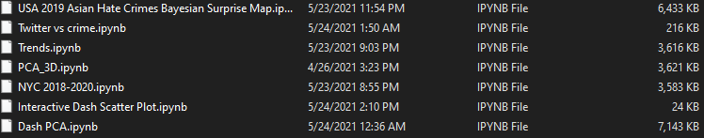
INTRODUCTION: We have chosen the topic Asian Hate Crimes for the data visualization project. The main reason behind choosing this topic is that in recent years, we have seen or heard about the hate crimes on Asian people more frequently through television or social media. This made us more familiar and curious to know more about this hate crime in detail. This visualization paper will be analysis the hate crime from 1991 to 2019 and will focus on the anti-Asian hate then compare the number of hate crime between 1991 until 2019 and we also find out what cause this situation. Visualization is a useful method to show the relation of the data and if you choose a right visualization of the data and also see how is the trend of the data. The past two years are the restless years because of the COVID-19 virus. There were many people dead and the economy also decreased for all the country. Although, there are already 2 years about the epidemic, the situation is not getting very better for the whole world. However, the situation is getting better than before in some countries which have the vaccine, such as US, China and so on. During the hard time of the epidemic, there appeared many of the crime and the hate crime increased very fast and most of the hate crimes were anti-Asian because of many people thought that the virus came from China and there hate Chinese, thus there were some people attacked Asian no matter if there were Chinese. Because of this situation, we decide to make a visualization to see how’s the trend of hate crime from this few 10years or 20 years. We collected the data from the CDE (The Crime Data Explorer) which was a program from FBI’s Uniform Crime Reporting Program. The data we got was a csv file which included all kind of the hate crime data from 1991 to 2019. We separated it, analyzed it and use the analyzed data to make a visualization and saw how difference of the hate crime change.
Visualization programs we designed for this study:

Slide 4


DATA SET THAT HAS BEEN USED
FBI Hate Crime Statistics Data Set:
The Hate Crime Statistics dataset provides annual statistics on then umber of incidents, offenses, victims, and offenders in reported crimes that are motivated in whole, or in part, by an offender’s bias against the victim’s perceived race, gender, gender identity, religion, disability, sexual orientation, or ethnicity. Hate Crime data are captured by indicating the element of bias present in offenses already being reported to the UCR Program.
https://raw.githubusercontent.com/visualization-project-group/surprise-map-assignment/master/hate_crime.csv
NYC Hate Crime Report Data Set:
NYC Hate Crime Report Data set is an arrest statistics involving hate crime incidents. The following data are collected: Arrestee Gender, Race, Age and Bias Motivation.
https://raw.githubusercontent.com/Lsx961029/DATA-SET/main/hate-crime-arrests-by-motivation-annual-2018.csv
Tweeter Data Set:
Data set collected by utilizing Support Vector Machines (SVM), a supervised machine learning model to label the tweets. State and year specific racial sentiment data are then merged with state and year specific data on hate crimes, racial attitudes from the General Social Survey, and explicit and implicit bias from Project Implicit.
https://raw.githubusercontent.com/visualization-project-group/surprise-map-assignment/master/tweeter_data.csv

Slide 5
Definition of Hate Crimes
Hate crimes are crimes motivated by race, religion, sexual orientation, or racial prejudice. In some states, it includes bias against gender, age, and gender identity. Hate crime laws have been passed in 47 states and the federal government since the 1980s.Currently,only Arkansas, South Carolina, and Wyoming do not have hate crime laws. To be prosecuted as a hate crime, the crime – whether battery, murder, or vandalism – must be an act of direct assault on a person motivated by prohibited prejudice. In other words, hate crimes punish motivation; Prosecutors must convince a judge or jury that victims were targeted because of their race, faith, sexual orientation, or other legally protected characteristics.

Slide 6
Visualization 1: PCA Visualization of Asian Hate Crime
We build two PCA visualization based on the count of Asian hate crimes during 1991-2019 in different regions of America. We choose each region in each year within the range as an instance and use different offender race count of Asian hate crimes as attributes. Initially, in the figure 1 we have7×7scatter plot matrix which contains 7 variables for each instance. Then we use dash transformed it into a PCA which contains 2-6 variables accordingly. Therefore, a7 dimensional system can be reduced to 2-dimensional system which has an explained variance 69.74%. The total variance is the sum of variances of all individual principal components. The fraction of variance explained by a principal component is the ratio between the variance of that principal component and the total variance. The second PCA we have is just an example of 3 Components in a 3dimensional system. We may find the points with same color as a cluster since the population and race difference in different regions of America.

Slide 7
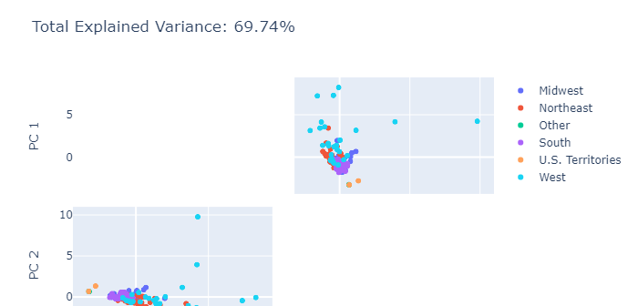
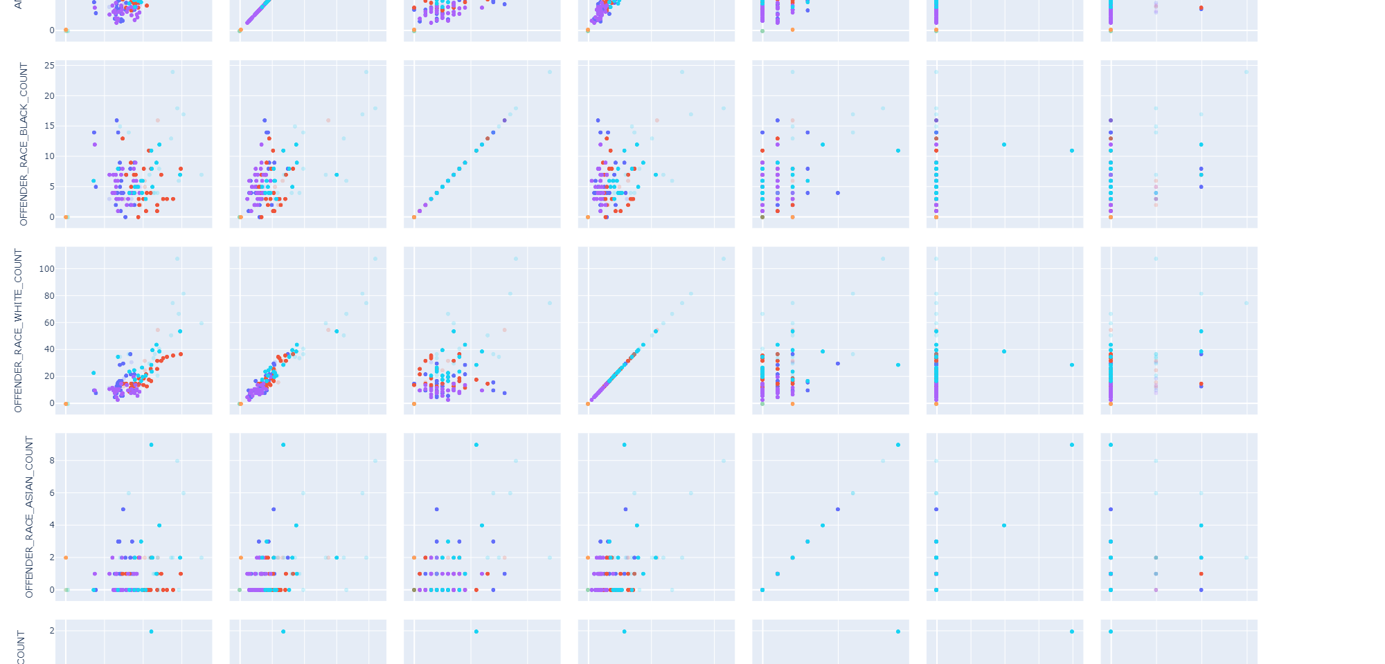
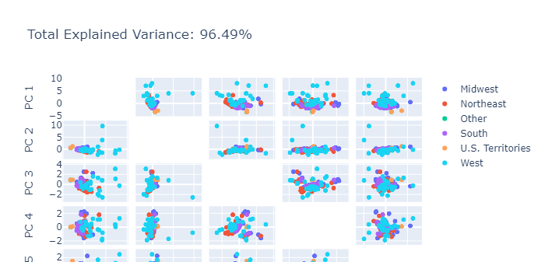
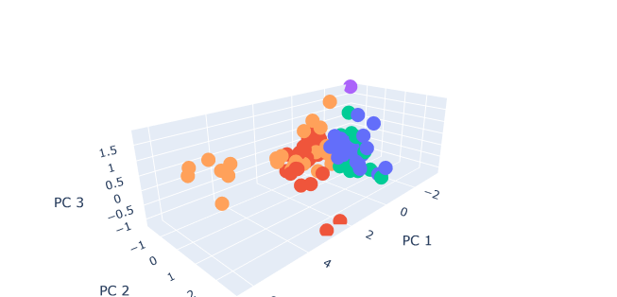

Slide 8
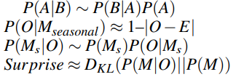
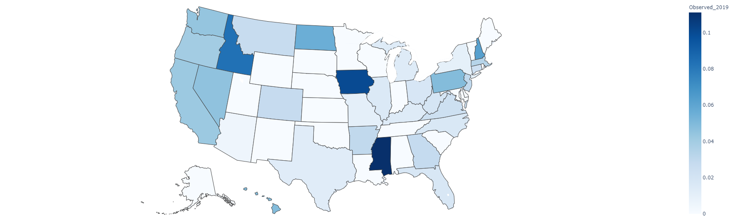
Question 1: What’s the level of Asian Hate in 2019 before COVID-19
There are 3 important graphs in this visualization. First, we made his USA 2019 Asian Hate Crimes Rate Observed Heat Map to show the proportion of Asian hate crimes over all kinds of hate crimes and the proportion is color encoded. We can see that in 2019,Iowa, Idaho and Mississippi have a high Asian hate crime rate and some states like South Dakota, Minnesota, etc...They have a Asian hate crime rate which is 0. As we know simple heat map has no accounting for confounds and also has no accounting for variance. Then we process the data and calculate the surprise. The following are the formulas:

Slide 9
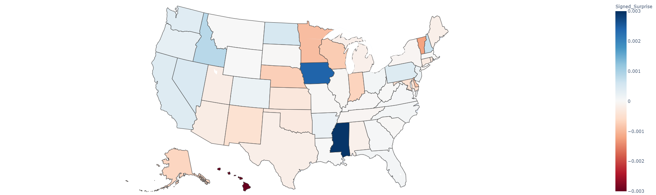
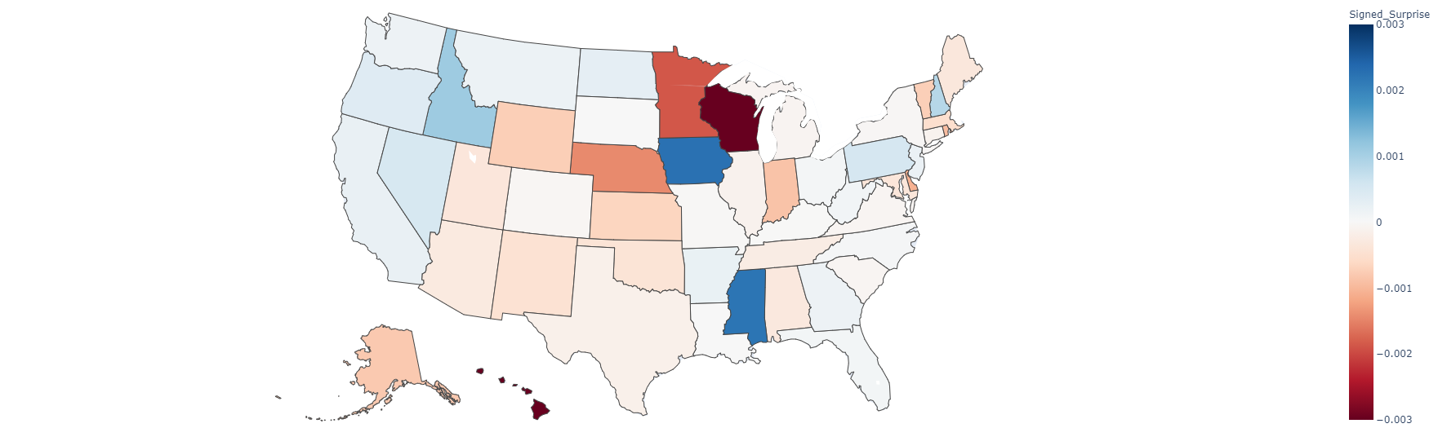
The following 2 surprise maps are based on last 10 years and last 20 years respectively:
Comparing 2019 with last 10 years, Iowa and Mississippi do have an unmoral Asian Hate rate appears in the surprise map. However, a lot of the states also the decreasing trends for the proportion of Asian hate crimes over all kinds of hate crimes.
If we look back even farther. Comparing 2019 with last 20 years, we can find a larger variance between each state. The state like South Dakota, Minnesota and Wisconsin pop up showing a large decreasing on the proportion of Asian hate crimes.

Slide 10
Question 2: What are the time in history when hate crimes had a higher occurrence than other times?
The visualization function is that the Y-axis is the number of people, and the X-axis is year. The attribute also includes Anti Asian, Anti-White, Anti-Black or African American, Anti-Hispanic or Latino, Anti-American Indian, Alaska Native, and all hate Crimes. In addition, each color represents each attribute, which enables us to understand better the total hate crime of each year and the cases of each race. In addition, we went for three years, five years, ten years, and all of them. In this way, we can find the required number of years and quickly compare the data of these three years. At the same time, when we want to know the number of hate crimes in each year in detail, we can use the mouse to click each year to be prepared to know how many cases occur each year and each race.
The number of routes in 2019 is growing significantly faster than in the past decade. Moreover, the numbers are growing faster in some states, where Asian-Americans commit significantly more hate crimes than their race. In this visualization, we can see that anti-Asian populations are increasing again after 15 years of decline. The FBI has released Hate Crime Statistics (2019), an updated compilation of the Uniform Crime Reporting (UCR) project covering bias-based motivated incidents across the country. In 2019, data submitted by 15,588 law enforcement agencies provided information on crime locations, victims, offenders, and hate crimes. Law enforcement agencies filed 7,314 criminal cases, including 8,559 involving race, ethnicity, descent, religion, sexual orientation, disability, gender, and gender identity

Slide 11
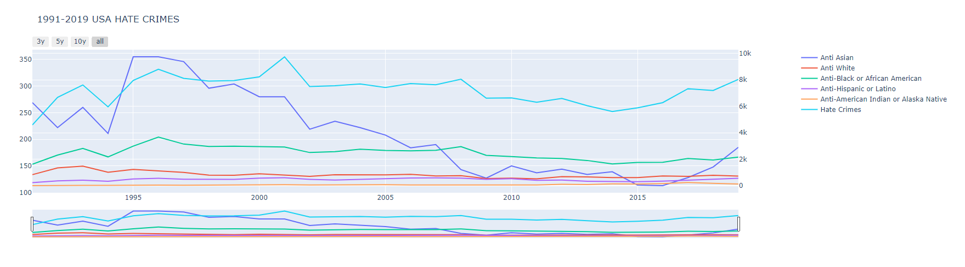
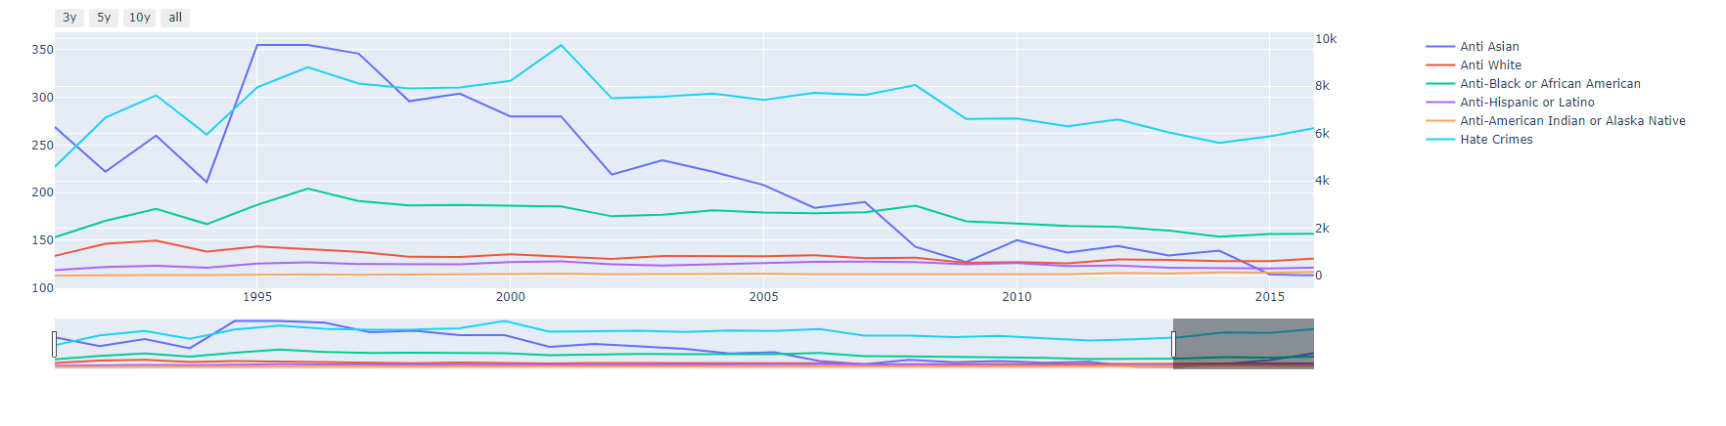
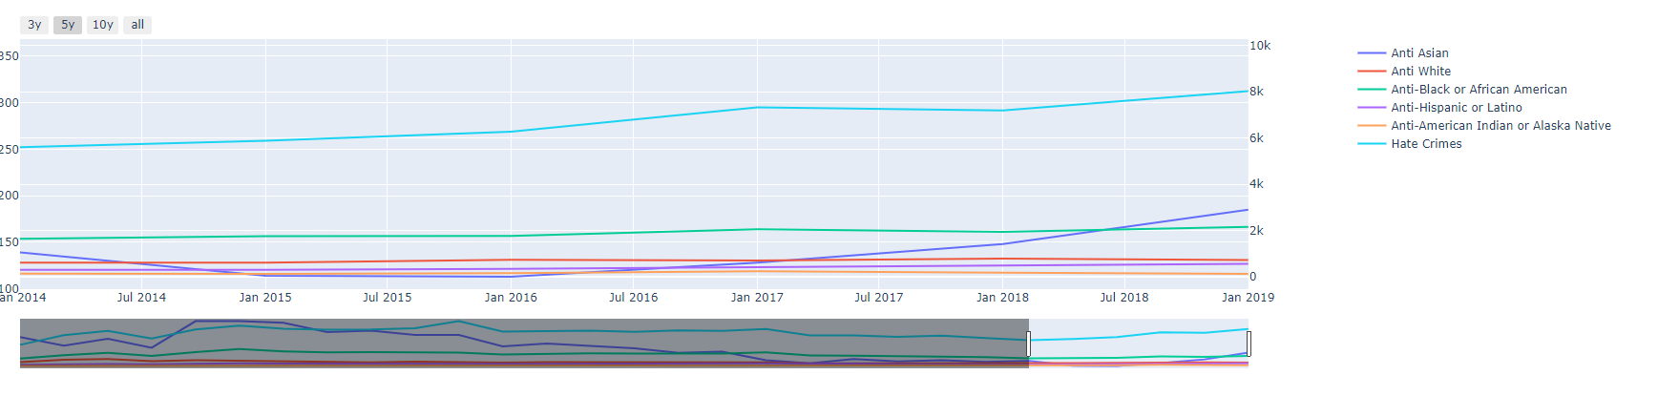
The US National Security Strategy Report released by the Trump administration on December 18, 2017 regards China as its primary strategic competitor. The trade war between China and the US has affected the relationship between China and the US. Through news reports and some untrue news, other races feel more hate towards Asian people, believing that Asian people are preventing the development of the US. Rising suspicions and worst-case scenarios have taken on a grim mood, raising the prospect of future political or military crises in Asia between the US and China that could end up propelling the two sides into a cold war or worse. As the balance of power in Asia shifts in the First Island Chain, the relationship between the two countries has become increasingly suspicious and hostile. The negative turn also reflects the region’s general failure to resolve several contentious issues, including the Korean Peninsula, Taiwan, maritime disputes and military-related intelligence, surveillance and reconnaissance activities. These factors make life easier for Asians under the pressure of American news. Therefore, after 2017 years, Asian hate crime began to increase rapidly again.

Slide 12

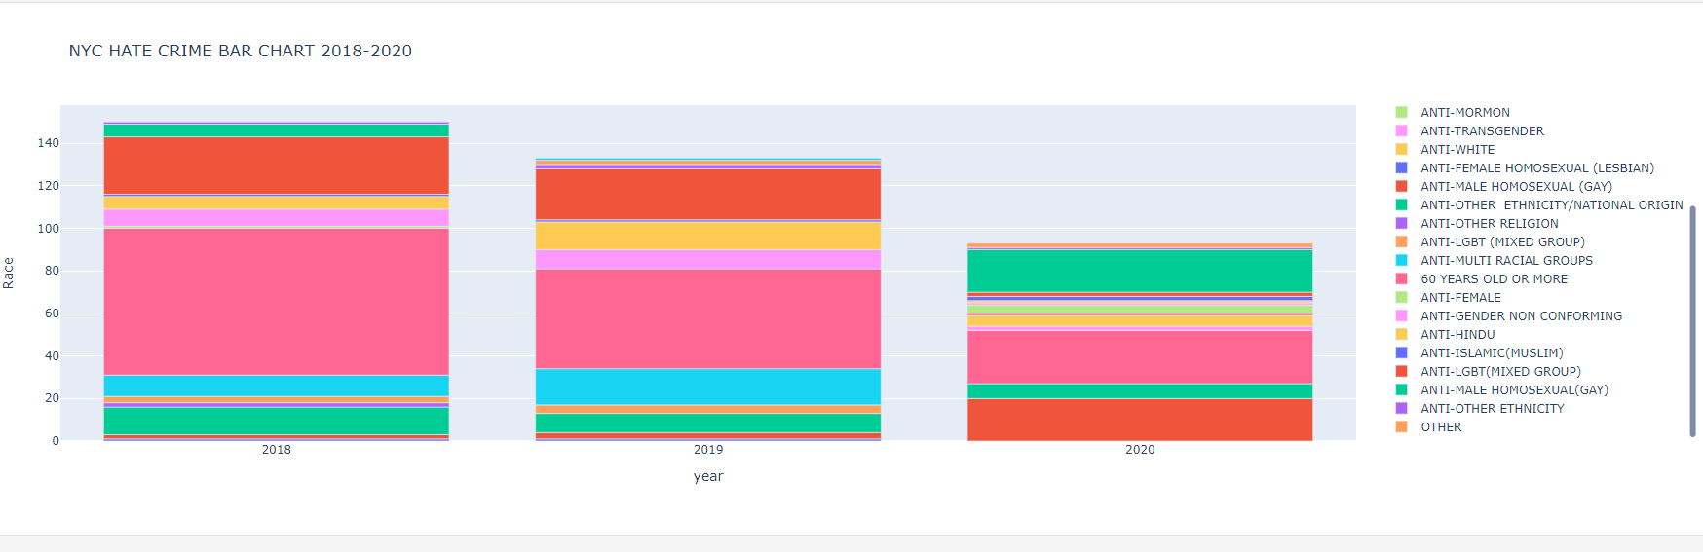
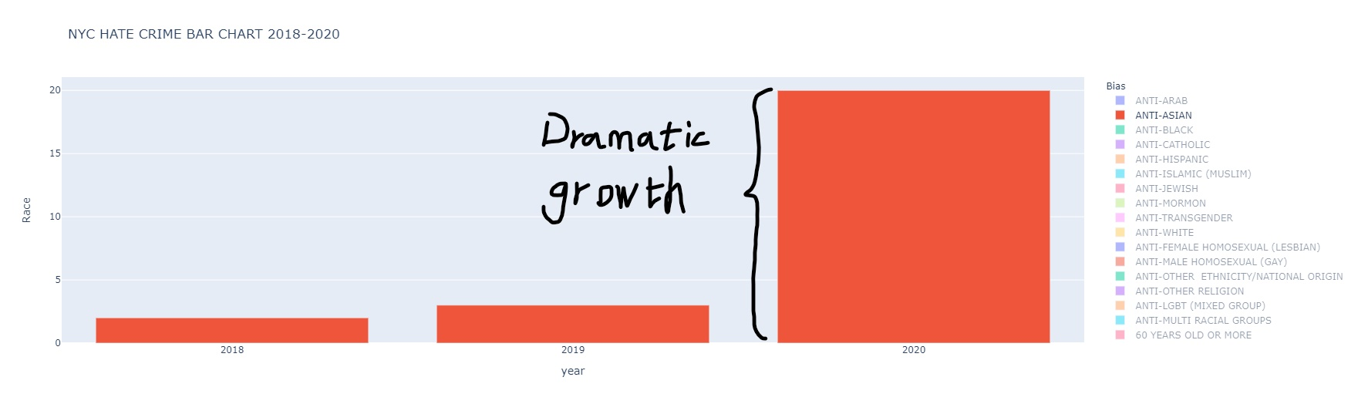
Question 3: The influence of COVID-19 to Asian hate between 2018-2020
This is a bar chart that analysis the anti-Asian before COVID-19 and during COVID-19. We have the select bar on the right side which can change the highlight on the bar chart. We only select the anti Asian to see how difference between 3 years. We can see that the red bar show the number of anti-Asian hate crime during that year. Number of anti-Asian hate crime almost 10 times of 2019 and 2018. The growth trend is dramatic. Because of the COVID-19, many of the Asian became the hate crime attack target by racist. There appear a website site which called Stop AAPI Hate to help Asian people to report crime. Most of the racist attack the old man/women and most of them do not speak English, thus they are hard to get help from other

Slide 13
Question 4: How does social media affect the rate of Asian hate crimes?
The twitter data collected 30,977,757 tweets from June 2015–July 2018 containing at least one keyword pertaining to specific groups (Asians, Arabs, Blacks, Latinos, Whites). The data set characterized sentiment of each tweet (negative vs all other) and averaged at the state-level. These racial sentiment measures were merged with other measures based on hate crime data from the FBI Uniform Crime Reporting Program. We want to show how the social media (based on tweeter data) affect the rate of Asian-hate crimes. The methods that we used is using scatter plot to show the relationship between anti-Asian tweets and anti-Asian crime rate at state level. Each points in the graph encodes each states, and the x-coordinate is the anti-Asian crime rate which is given by: the number of total Anti-Asian crime occurs in the state from June 2015-July 2018 over the number of total hate crime occurs in that state in the same period. And the y-coordinate is given by the percentage of sentiment tweets about Asian of all sentiment tweets.

Slide 14
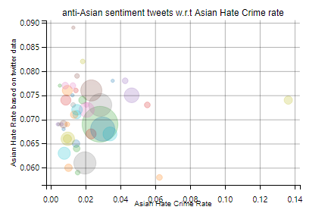
Figure 5. shows the result of the visualization. As we can see from the result, Tweets referencing Asians had a low proportion of negative sentiment (around 6% to 9%), respectively. The Delaware state has the highest proportion of negative sentiment tweets referencing to Asians, but the proportion of Asian crime in all hate crimes is still pretty low (around 2%). Actually, if we exclude some outliers in the data like the Delaware state, Hawaii state and Lowa state. Most state’s Asian Hate crime rate lies between the interval from 0% to 6%, and the rate of anti-Asian tweets is in between 6% to 8%. they form a cluster, not a linear relationship. This suggests that there is no positive correlation between negative social media sentiment against Asians and racial crimes against Asians.

Slide 15
In fact, this result can be verified by a paper Called ”Evaluating associations between area-level Twitter-expressed negative racial sentiment, hate crimes, and residents’ racial prejudice in the United States” [12], the paper uses the same data sets that we have. And the result states that Negative sentiment referencing other subgroups (Black, Asians, and Arabs) were also not significantly associated with hate crimes against the respective subgroup. Negative sentiment tweets referencing racial minorities as a group was not related to any hate crimes, which also confirms that our conclusion is correct from the side.

Slide 16
Question 5: What’s the relationship between the anti-Asian crime and the hate crime towards the other races in specific state/year? And is the anti Asian crimes correlated any offender’s race?
To solve this problem, we can implement a visualization that is a dynamic scatter plot. It can dynamically show the user selected variables of our FBI Hate crime data set as an axis of our dynamic scatter plot, the variables could either be the hate crime towards any specific race (in our case, Anti-Asian, Anti-Black or African American, Anti-White, Anti-American Indian or Alaska Native, Anti-Native Hawaiian or Other Pacific Islander) or the offender’s race recorded in anti-Asian crime case. The scatter plot is interactive, there is a slider bar provided for user to select a specific year, and each point of the scatter plot, encoding a state’s data corresponding to user’s selected variable. The scale of the scatter plot could either be linear based of logarithm based. There will be two-line charts next to the scatter plot, one of them is a line charts of how the x-variable changes for a specific state corresponding to the time changes, and the other one is also a line charts show that how the y-variable changes for a specific state corresponding to the time changes. When a user hover the mouse to any point of the scatter plot, the 2-line charts will dynamically change to the corresponding line charts of user’s selected variable of the user’s hovered state. Then we can see the result of the relationship of any of two variables of a certain state/year that in the data sets and see how those variables changes with respect to the time change.

Slide 17
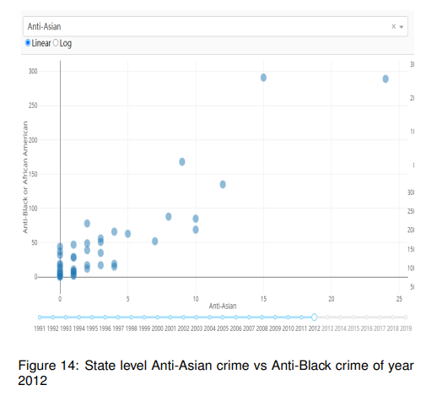
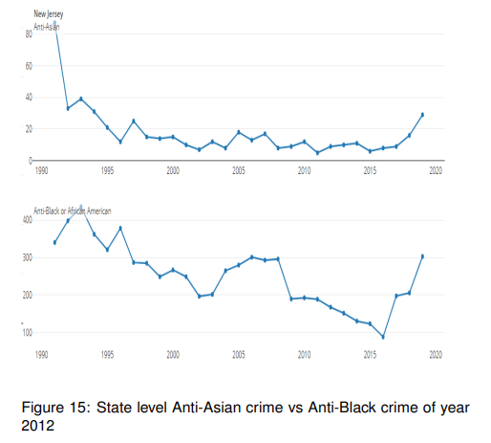
The visualization of this dynamic scatter plot allow us to show any of two relationship between hate crimes of any two race. for example. here is a figure that shows the state level anti-Asian hate crime vs. anti-Black hate crime of year 2012. As we can see from the result, it seems there is a positive correlation between the two variable since it seems the more anti-Asian crimes for a state has, the more anti-black crime cases for the state has.
And as we hover our mouse to any points in the scatter plot, as in this case, I hover the point of New Jersey, it shows the figures of line charts of the anti-Asian crime and anti-Black crime’s data of New Jersey with respect to the time changes.

Slide 18
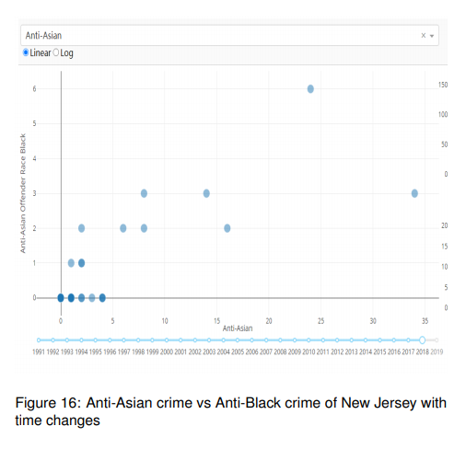
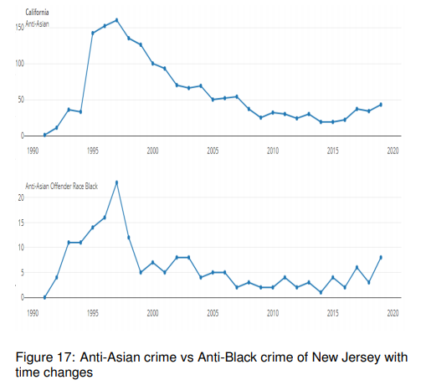
And this visualization can also show how the anti-Asian crimes correlated any offender’s race for any time and any state. For example, here is a figure shows that the state level anti-Asian hate crime vs. the anti-Asian offender race to be black of year 2018. As we can see from the result, we can also see some linearly relationship between the two variable since it seems numbers of the black offenders are correlated to the number of anti-Asian crimes.
And if we select a specific state, for instance, The state California in this case, the lines charts further provides an evidence since the two variables are more likely have the same trends.

Slide 19
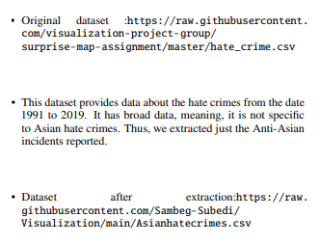
Question 6: Is the number of reported hate crimes throughout the year consistent? Does it spike during certain month?
Here, we have used the heatmap to detect which month or the season has the highest hate crimes. Using the Vega-lite, we have created the visualization, where the more concentrated color(blue) represents the higher number of victims whereas lighter color represents the fewer victims meaning, less crime. X axis represents the Month and Y axis represents the year. Through the code we determined the hate crime incident occurred in each month of the year. As per the visualization, we can analyze that during the interval from March to October, the hate crime rates are usually higher. However, we could not see any trends, spikes, or clusters over certain seasons such as summer, spring, or winter. From this, we can conclude that several factors and incidents lead to hate crimes, not just a single factor. If just a single factor was responsible, then there would be some cluster or concentrated color just over certain months or for some interval.

Slide 20
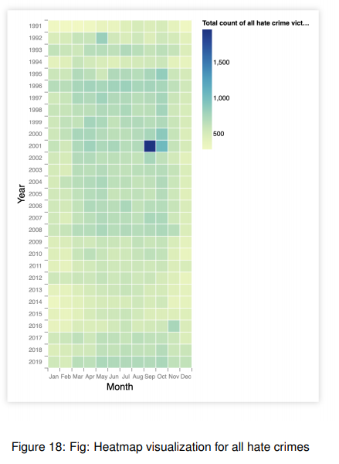
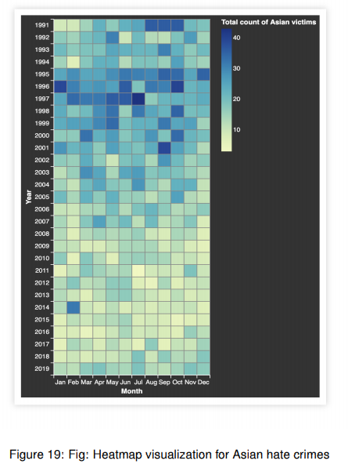
Similarly, for Asian hate crimes too, we couldn’t see any spikes or any clusters on certain season or months, indicating several factors are responsible for Asian hate crimes. However, we do see that from year 1991 to 2007 the number of Asian hate crime was higher and from 2007 to 2017 the crimes decrease but from 2017 the number of such incident again start increasing.

Slide 21
LIMITATION AND SCOPE
The data was old, and we did not know whether the people who collected the data were biased or not. And because many people had received racial crimes they dared not report to the police. There was a frenzy of immigration between 1990 and 2000 and many of undocumented immigrants during that time. All of these are difficult to collect in the data and these factors make the data inaccurate. We are also hard to find the accurate data of 2020 COVID-19 anti-Asian hate crime. So now the data is limited and the data we got from Twitter also have those questions.

Slide 22
CONCLUSION
Through this project, we were able to implement different forms of visualization for different data types. We used Vega-lite and python code in Jupyter Notebook to create the visualization. Through the visualization, we are able to determine regions and states with higher hate crimes, analyzed if there are any spikes on certain months or seasons, found out the most probable location and offense type for such hate crimes in the United States.
We found that PCA is not that useful to describe Anti-Asian hate because there are not too many related attributes between each case of Anti-Asian crime. However, Bayesian Surprise Map is a very good way to visualize the related change of Asian hate crime in a certain time. It uses color saturation to remind people which state has a higher ”surprise” value. Also the geographical information is encoded as a intuitive map to let viewers directly relate the ”surprise” value of each state.
We might have many guess that why anti-Asian rate change from high to low and from low to high from 1991 to 2019. However, there are only one guess for the anti-Asian hate crime increase from 2018 to 2020, that’s because the COVID-19.Through the line chart, through the Scatter Plot, I know the Asian hate crime rate over the last 20 years, why 1998 was the highest hate crime rate in the previous 20 years, and then it went down. In addition, because of the spread of epidemic rumors, Asian hate crimes have peaked in 10 years.
Many people may think that social media hate comments against Asians affects the rate of hate crimes against Asians, but in reality, they are not necessarily related. The result states that Negative sentiment referencing subgroups of Asian were also not significantly associated with hate crimes against the respective subgroup. Negative sentiment tweets referencing racial minorities as a group was not related to any hate crimes.

Slide 23
Contributions:
Yi Lin: Working on the paper ( research on question 4, question 5) and record the videos to show the visualization representation, the code of twitter vs crime visualization, the code of interactive scatter plot, and the partial code of both PCA and surprise map.
Shuoxin Liu: Working on the paper( research on visualization 1,question 1) and presentation posters, the code of NYC 2018-2020, the code of Trends 1991-2019, and the partial code of both PCA_3D and surprise map.
Huihong Yu: Working a lot on the paper, research on Question 2 and the partial code of Trends 1991-2019 and surprise map.
Ruixiang Huang: Working on the paper and record the videos to show the visualization representation, research on Question 3 and the partial code of NYC 2018-2020 and surprise map.
Sambeg Raj Subedi: Working on code and paper of research question 6.
Dor Ulman: Working on research question.

